Slide 1
How to Help Prepare & Better Protect Your Finances in 2021
– WEBINAR –

Slide 2
Introduction
To say 2020 has been a shocking year that we will never forget is no understatement. Thankfully, 2020 is coming to an end.
Now, we must prepare for whatever the new year might bring. It doesn’t matter who you voted for, or what your political affiliation is. We’re all in the same boat now and must hope for the best but be prepared for the worst.

Slide 3
Topics Covered
How the New Administration Could Impact the Financial Markets
Tax-Saving Strategies under the New Administration
How Inflation Rates Could Rise as the Fed Prints More Money
Income Strategies in a Low Interest Rate Environment
How Increased Corporate Taxes Could Impact the Market
Strategies for Dealing with New Capital Gains Tax Rates
The strategies we will cover today can help protect what you’ve worked so hard to earn and can help keep you on track to enjoy the retirement you’ve always envisioned.

Slide 4
You will want to stay until the end if:
You are retired and don’t want to reduce your lifestyle or go back to work
You plan to retire within the next 10 years and don’t want to postpone it
You’re not sure how the Biden Administration will affect your money

Slide 5
If you stay until the end,
You’ll receive a SPECIAL OFFER!

Slide 6
The Election Outcome’s Impact
Presidential “Honeymoon Periods”
Stock Market History
Investing for Income
On the Financial Markets

Slide 7
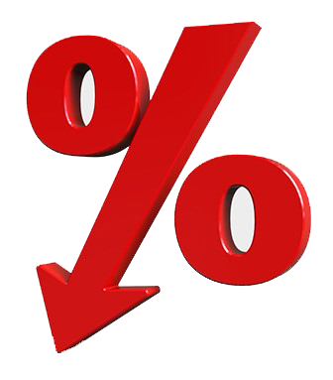
The Theoretical Stock Market Effects of Low Interest Rates
Stock Valuations
Borrow Money
are higher, mathematically speaking
cheaper to make major purchases
Corporations
Investors
can borrow money cheaper to buy back stock
move “up the risk curve” because interest-bearing options “appear” less attractive
The result: stocks “should” go higher.

Slide 8
But there’s still…
High Unemployment
Over 10%
A Shrinking Economy
GDP lower than it was on 1/1/2020
Aging Baby Boomers
Less likely to use debt as a financial tool.
High Uncertainty
Will we get another virus flare up?
When will we have a vaccine?
How effective will the vaccine be?
Politics
International Relations

Slide 9
Tax-Saving Strategies
Healthcare Spending
Charitable Donations and the CARES Act
Estate Planning
Going Green
IRA Contributions
Under the New Administration

Slide 10
How Inflation Rates Could Rise
What is Inflation?
Economic Stimulus Payments
Asset Bubble
Steady Streams of Income
As the Fed Prints More Money

Slide 11
“The Big Mac Index” & Stamps
Source: https://seekingalpha.com/article/4119246-big-mac-index-may-be-telling-truth-inflation

Slide 12
1.2%
U.S. inflation rate ended October 2020
Source: https://www.bls.gov/news.release/pdf/cpi.pdf

Slide 13
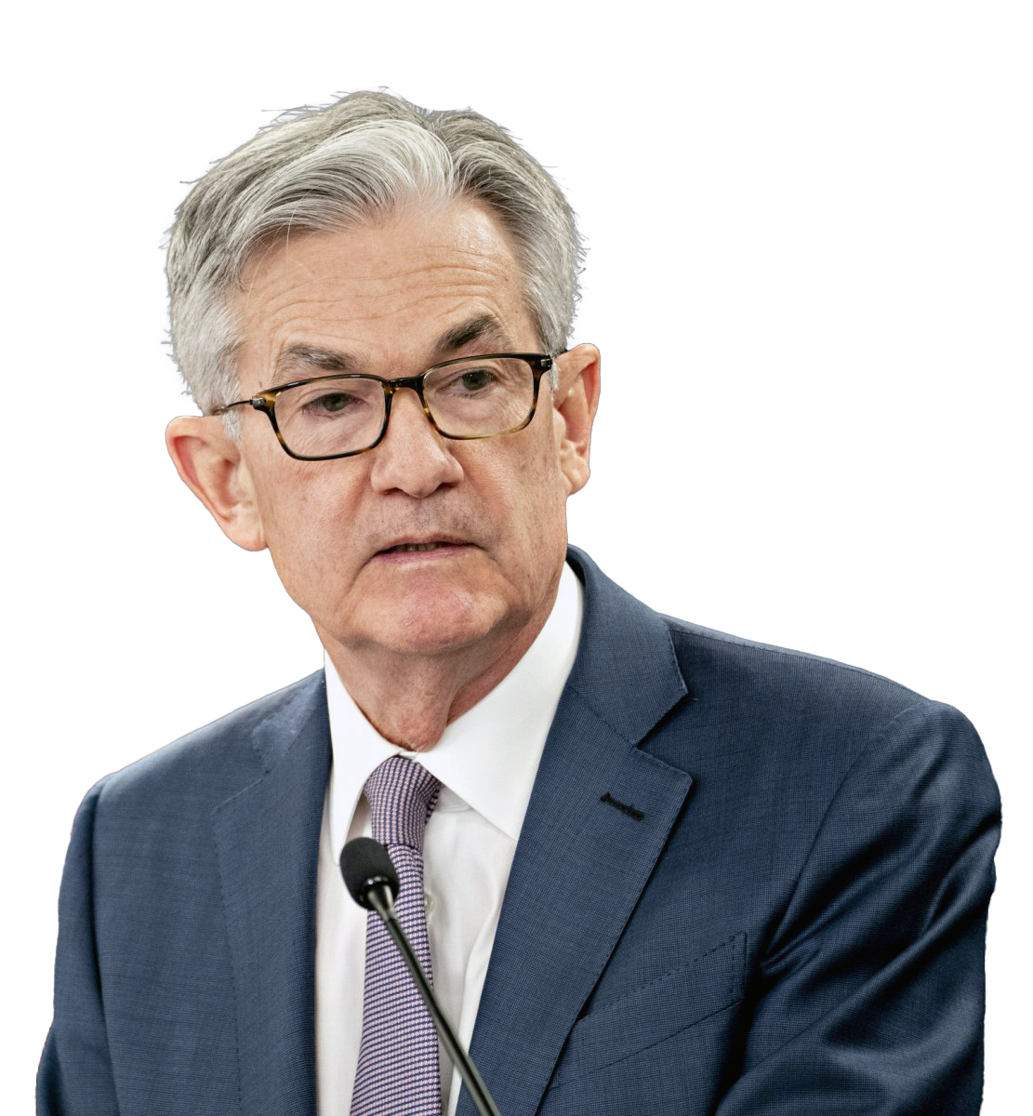
“We’re not even thinking about raising rates.”
— Jerome Powell, Federal Reserve Chairman

Slide 14
Income Strategies
Investing for Income
The Stock Market
Bonds and Bond-Like Instruments
Value Strategy
in a Low Interest Rate Environment

Slide 15
Increased Corporate Taxes
President Trump Corporate Tax Cuts
Reduction or Repealing of Corporate Tax Cuts
Stock Prices
Georgia Runoff Elections
How They Could Impact the Market

Slide 16
New Capital Gains Tax Rates
What are Capital Gains?
Tax Cuts and Jobs Act of 2017
Tax Brackets
Tax-Loss Harvesting
and Strategies for Dealing With Them

Slide 17
LONG-TERM CAPITAL GAINS TAX RATES
2020
2021
Filing Status | 0% Rate | 15% Rate | 20% Rate
Single | Up to $40,000 | $40,001 - $441,450 | Over $441,450
Married filing jointly | Up to $80,000 | $80,001 - $496,600 | Over $496,600
Married filing separately | Up to $40,000 | $40,001 - $248,300 | Over $248,300
Head of Household | Up to $53,600 | $53,601 - $469,050 | Over $469,050
Filing Status | 0% Rate | 15% Rate | 20% Rate
Single | Up to $40,400 | $40,401 - $445,850 | Over $445,850
Married filing jointly | Up to $80,800 | $80,001 - $501,600 | Over $501,600
Married filing separately | Up to $40,400 | $40,001 - $250,800 | Over $250,800
Head of Household | Up to $54,100 | $54,100 - $473,750 | Over $473,750
Sources: https://www.aarp.org/money/taxes/info-2020/income-tax-brackets.html

Slide 18
TAX BRACKETS
Income Earned in 2021 | Income Earned in 2020
37% for incomes over $523,600 ($628,300) 35% for incomes over $209,425 ($418,850) 32% for incomes over $164,925 ($329,850) 24% for incomes over $86,375 ($172,750) 22% for incomes over $40,525 ($81,050) 12% for incomes over $9,950 ($19,900) 10% for incomes up to $9,950 ($19,900) | 37% for incomes over $518,400 ($622,050) 35%, for incomes over $207,350 ($414,700) 32% for incomes over $163,300 ($326,600) 24% for incomes over $85,525 ($171,050) 22% for incomes over $40,125 ($80,250) 12% for incomes over $9,875 ($19,750) 10% for incomes up to $9,875 ($19,750)
($) = for married couples filing jointly. Married filing separately pay at same rate as unmarried.
Sources: https://www.aarp.org/money/taxes/info-2020/income-tax-brackets.html

Slide 19
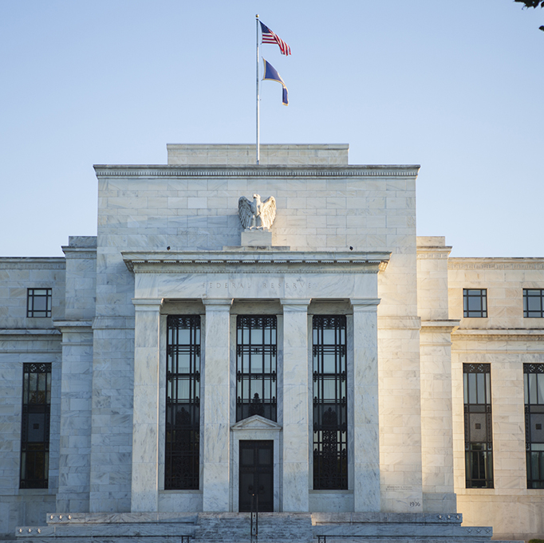
Please don’t sit on your hands thinking:
No one cares more about your money than you!
Congress will protect you
The Fed will protect you
Your advisor knows how to protect you

Slide 20
What are your next steps?
Schedule the delivery of your Personalized Retirement Readiness Analysis today
Find out which of the three strategies best fits you
Make sure your current and future income needs are satisfied from the “I”

Slide 21
Many advisors charge over
$1,000
for their analysis.

Slide 22
Personalized Retirement
Readiness Analysis
FREE
$1,000
Special No-cost Offer Today!
Schedule your appointment NOW to get your FREE analysis!

Slide 23
THANKS
Do you have any questions?
[email address]
[phone number
[website url]
[INSERT DISCLAIMER HERE]

